Slide 1
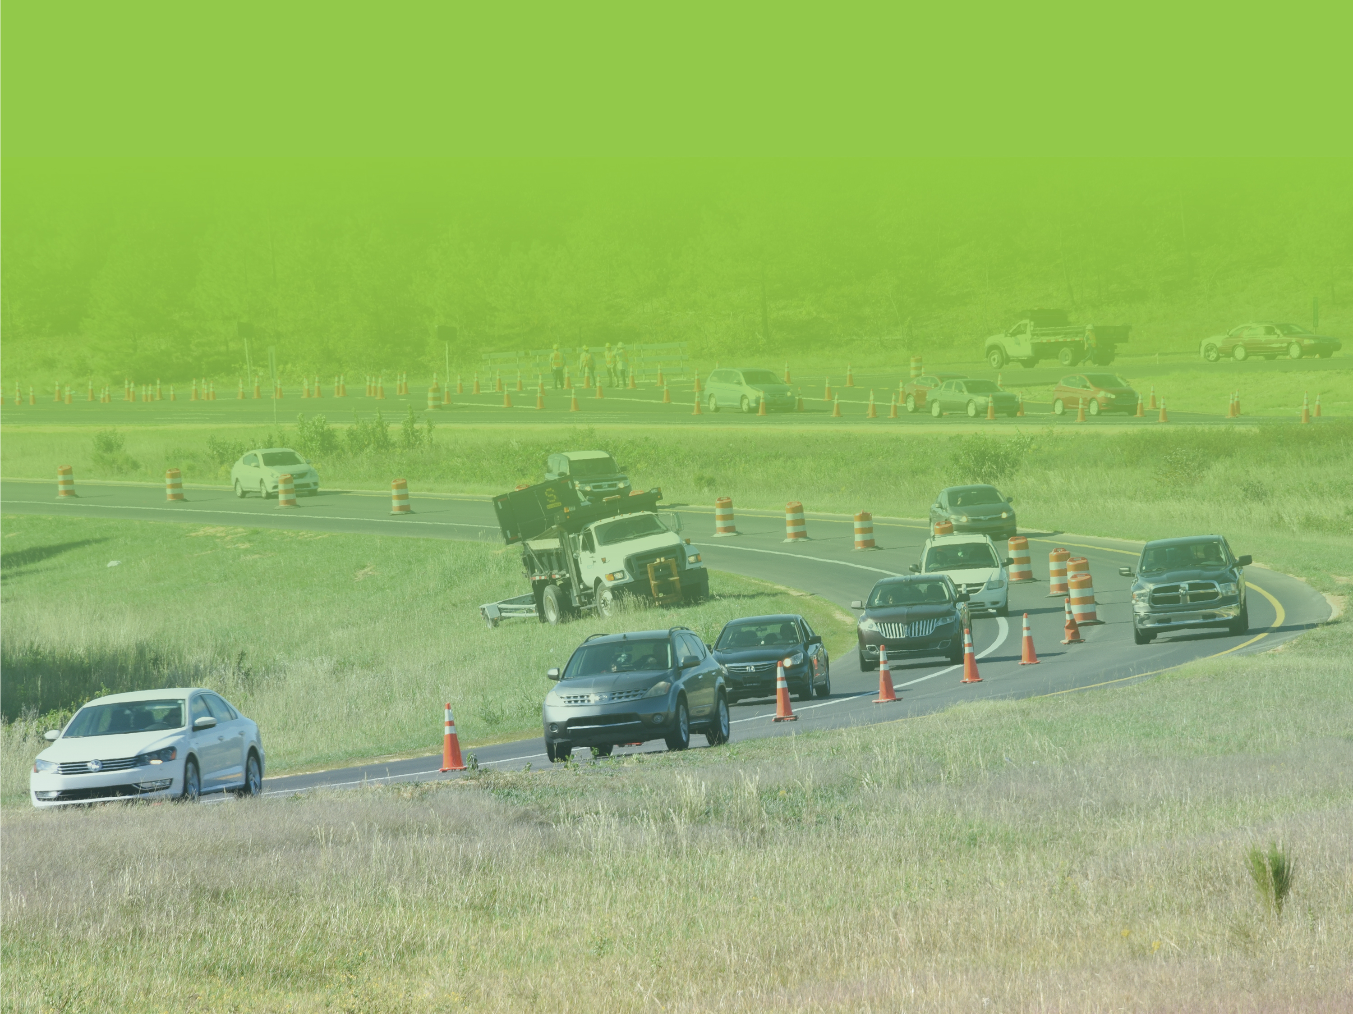

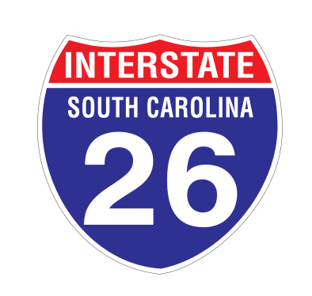


LANE REVERSAL
Improvements
May 21, 2020 Commission Meeting

Slide 2

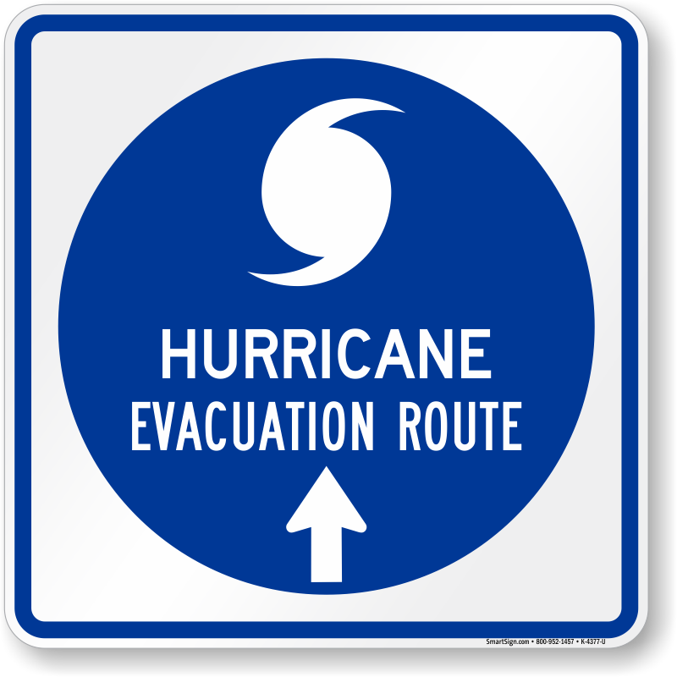
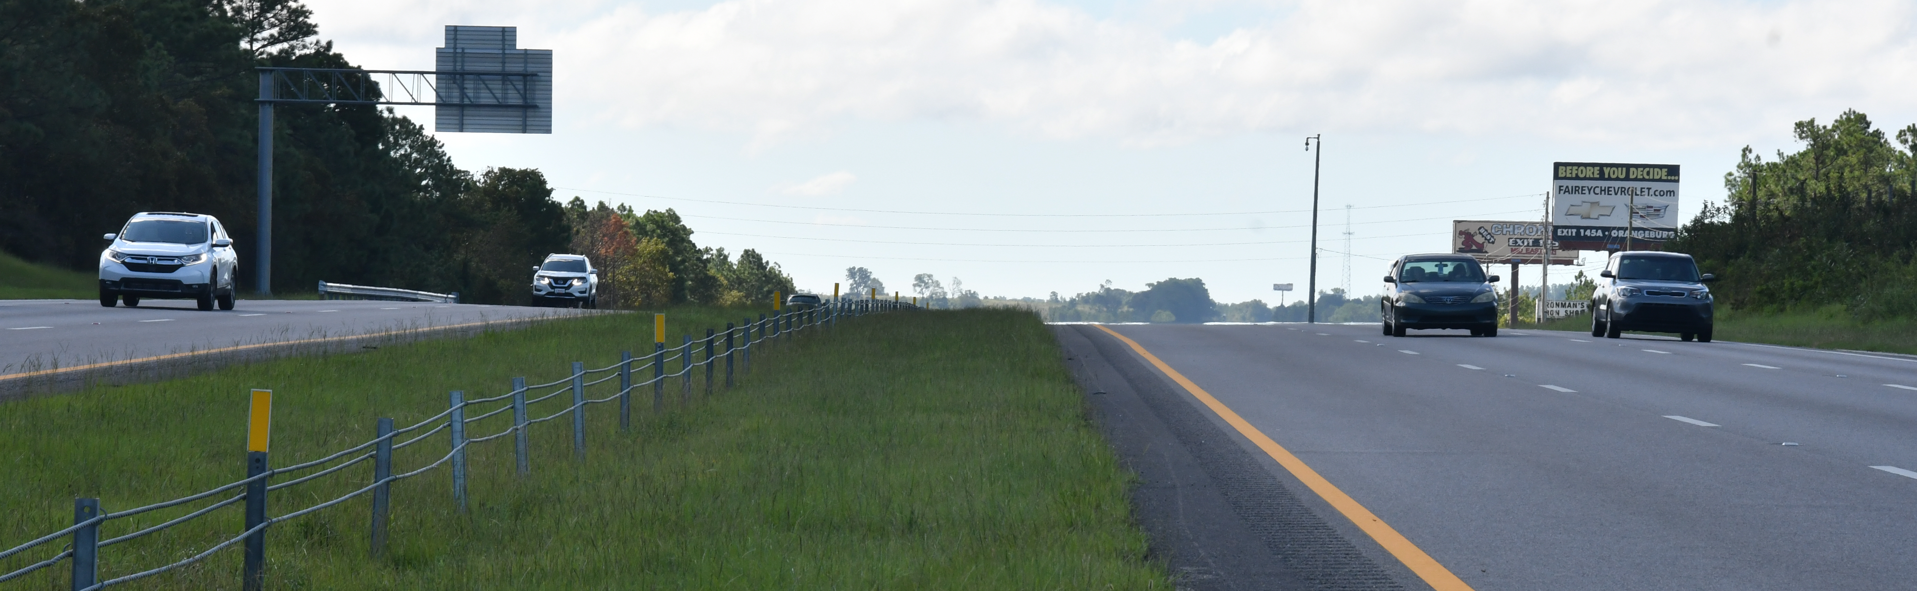
TIME FOR A TUNE-UP
Hurricane Floyd - 1999 – Original Plan Developed
Hurricane Matthew - 2016 - First Implementation
Hurricane Florence – 2018
Hurricane Dorian – 2019
17 years
2
Notes:
In the 21 years since the plans development, the I-26 corridor has undergone some changes
Notably, Widening from four to six lanes in Charleston and Columbia metro areas
Industry Growth in the area including Port Expansion and increased use of Charleston airport.
Interchange work including US 17 realignment at Exits 220 & 221.
Additions of three new interchanges: Port Access Road, Nexton Parkway, & Volvo Car Drive
In Columbia, the addition of the Amazon Distribution Center and Dominion Energy office at I-77 Exit 2 (12th Street Extension in Cayce)

Slide 3
TUNE-UP TO SIMPLIFY & IMPROVE
Shortened the length by 15 miles
Changed the end and beginning configurations
Added additional entry points for the reversed side
3

Slide 4
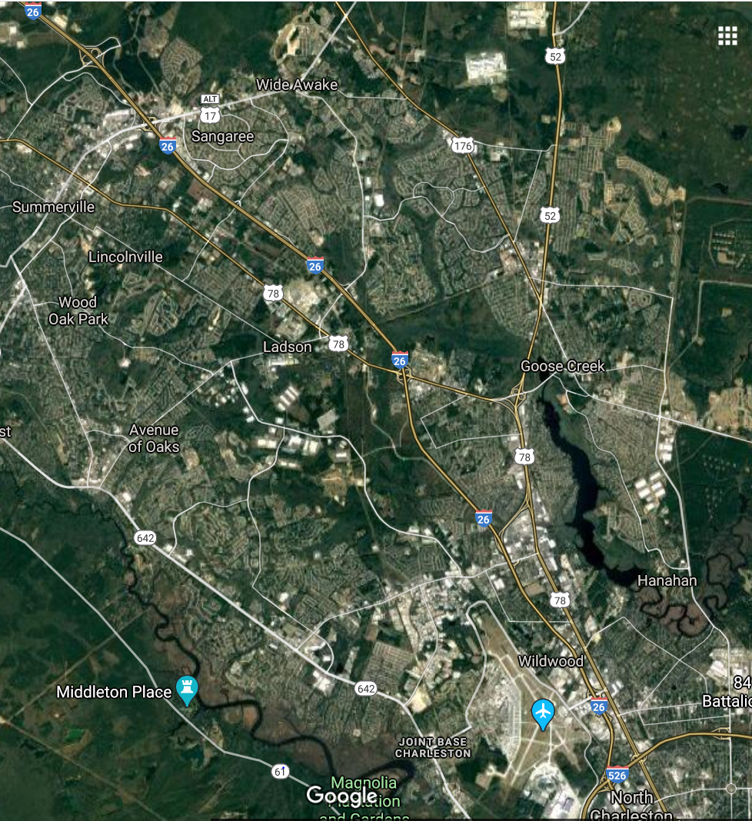
CHARLESTON END
Begin Reversal at Nexton Parkway
Shortened by 15 miles
Takes advantage of existing 3 lanes heading WB
Install a new cross-over just above Nexton Parkway
Unrestricted access to Airport
Shortened Section: EB and WB to operate normally
7
4

Slide 5
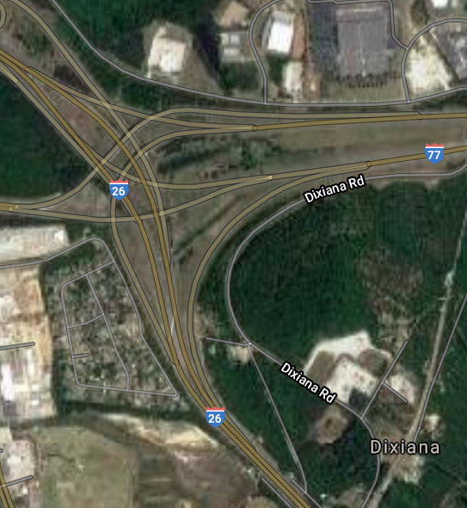
COLUMBIA END
End Reversal at I-77 Interchange
Removed mandatory diversion to I-77
Utilize existing cross-over
Instead of forcing the un-reversed side of I-26 to I-77, motorists will now have the option to remain on WB I-26.
5

Slide 6
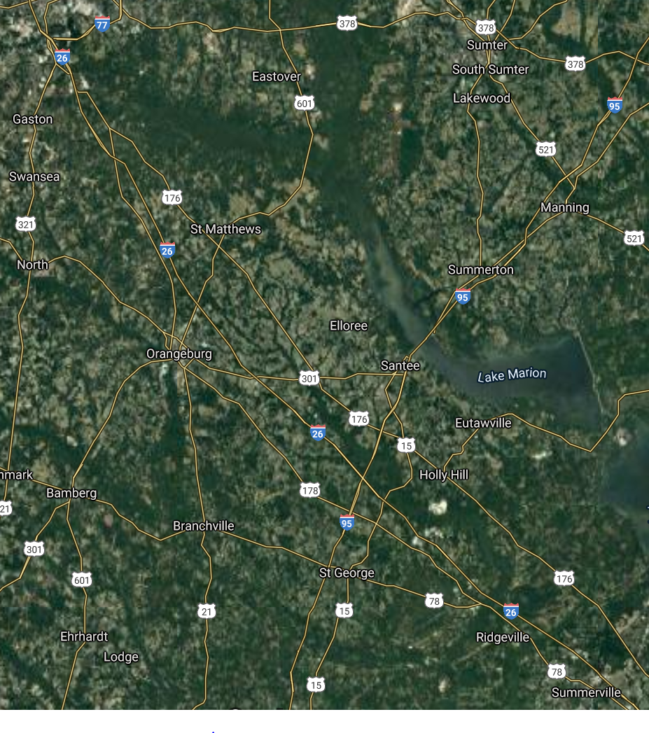
ADDITIONAL ENTRY POINTS TO REVERSED SIDE
Exit 159 Homestead Road
Exit 139 Burke Road
Diamond Interchanges, each with large gas stations
6

Slide 7
Questions
7

Slide 8
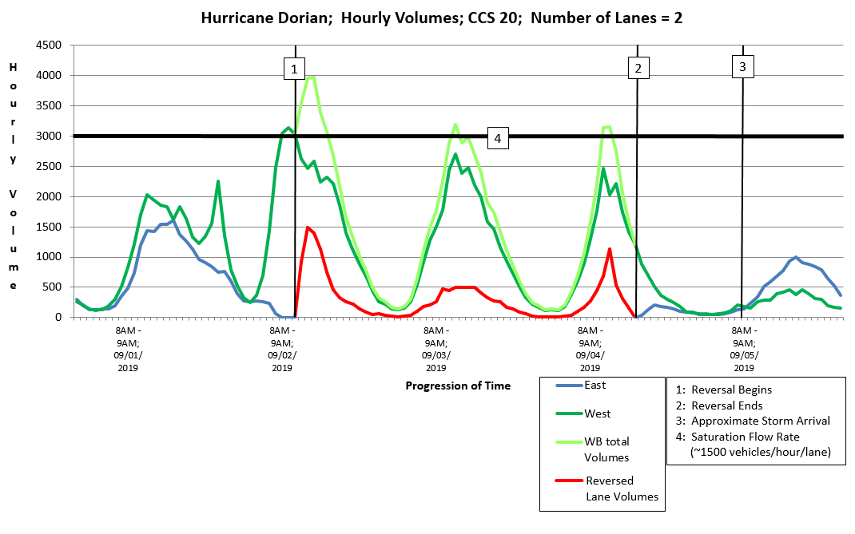
TRAFFIC VOLUME ANALYSIS

